Slide 1
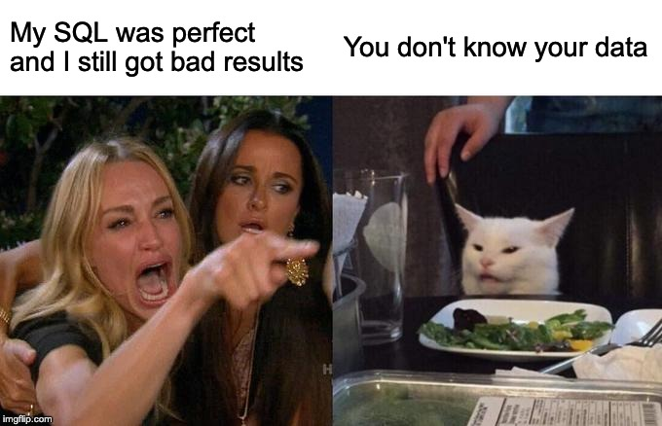

Slide 2
Know your data
Primary Keys
Foreign Keys (Parent / Child Relationships)
Indexes
emp
dept
Notes:
This Entity Relationship Diagram (ERD) shows the parent / child relationship between dept and emp. Dept is a parent of emp. 1 dept can have many emp rows. An emp row can have only 1 dept parent row. If an emp has no dept, it is considered an orphan. We will use these 2 tables throughout this session.

Slide 3
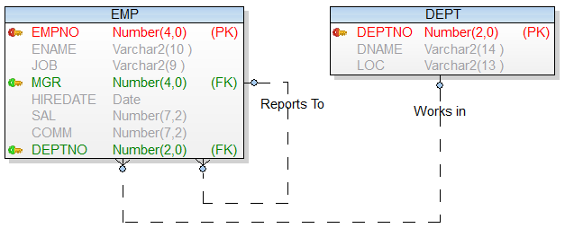
Know your data
Notes:
This Entity Relationship Diagram (ERD) shows the parent / child relationship between dept and emp. Dept is a parent of emp. 1 dept can have many emp rows. An emp row can have only 1 dept parent row. If an emp has no dept, it is considered an orphan. We will use these 2 tables throughout this session.

Slide 4
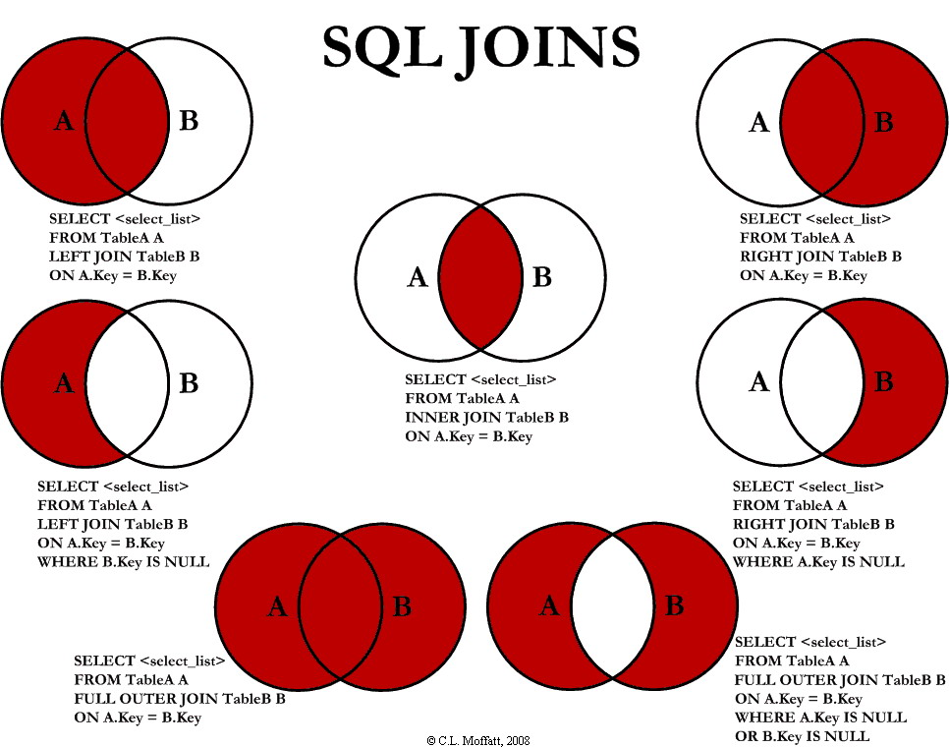
Notes:
Here are some of the join types we will discuss.

Slide 5
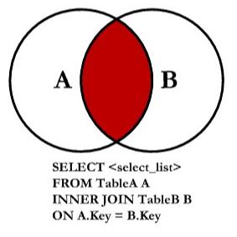
Joins – Inner Join
Simple join covered in session one
Also called ‘equijoin’
-- ANSI JOIN syntax
SELECT *
FROM emp a
JOIN dept b
ON a.deptno = b.deptno
-- "Nice" ANSI JOIN syntax – Oracle
SELECT *
FROM emp a
JOIN dept b
USING (deptno)
-- "Classic" join syntax
SELECT *
FROM emp a,
dept b
WHERE a.deptno = b.deptno

Slide 6
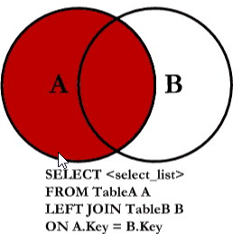
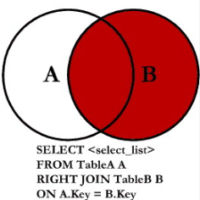
Joins – Outer Join
Left (outer) Join / Right (outer) Join
-- Left (outer) Join
SELECT *
FROM emp a
LEFT JOIN dept b
ON a.deptno = b.deptno
-- Right (outer) Join
SELECT *
FROM emp a
RIGHT JOIN dept b
ON a.deptno = b.deptno
-- Oracle variant
SELECT a.*, b.*
FROM emp a,
dept b
WHERE a.deptno(+) = b.deptno
Notes:
The ‘Left’ table is the first table after the ‘FROM’ clause, or the ‘Left’ side of the join clause. Think of it as the ‘driving’ table.

Slide 7
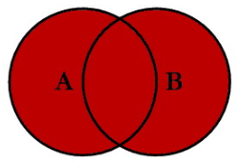
Joins – Full Outer Join
Not the same as union
-- Full (outer) Join
SELECT *
FROM emp a
FULL OUTER JOIN dept b
ON a.deptno = b.deptno
A
B
Notes:
Full outer join is not the same as a union, even though the diagram looks like a union.
Union will be described after a few slides.

Slide 8
Joins – Full Outer Join
Sample Report: Count employees by department
-- GOAL: List the number of employees by department.
-- Count from emp table is missing depts
select deptno, count(*)
from emp
group by deptno
SELECT *
FROM dept
-- Right Join
-- count(*) is counting rows.
SELECT b.deptno, count(*)
FROM emp a
RIGHT JOIN dept b
ON a.deptno = b.deptno
GROUP BY b.deptno
-- count(a.empno) will not count nulls
SELECT b.deptno, count(a.empno)
FROM emp a
RIGHT JOIN dept b
ON a.deptno = b.deptno
GROUP BY b.deptno
-- Left Join
SELECT b.deptno, count(a.empno)
FROM emp a
LEFT JOIN dept b
ON a.deptno = b.deptno
GROUP BY b.deptno
-- Full Join
SELECT b.deptno, count(a.empno)
FROM emp a
FULL JOIN dept b
ON a.deptno = b.deptno
GROUP BY b.deptno
A
B
Notes:
Full outer join is not the same as a union, even though the diagram looks like a union.
Union will be described after a few slides.

Slide 9
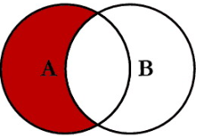
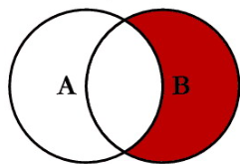
Joins – Anti Join
Using outer join
Using ‘not in’
Not the same as a ‘minus’ query.
-- Rows from A that don’t join to B
SELECT *
FROM emp a
LEFT JOIN dept b
ON a.deptno = b.deptno
WHERE b.deptno is null
-- Rows from B that don’t join to A
SELECT *
FROM dept b
WHERE deptno not in
(select distinct deptno
from emp a
where deptno is not null)
Notes:
Show me all rows from A except the rows that join to B
Not the same as a minus query. Will show that in a minute.

Slide 10
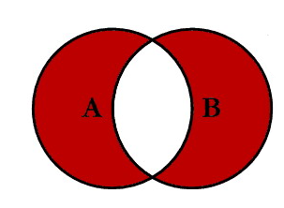
Joins – Full Anti Join
Full Join without intersection
Show rows from a, not in b AND b, not in a
-- Full (outer) Join
SELECT *
FROM emp a
FULL OUTER JOIN dept b
ON a.deptno = b.deptno
WHERE a.deptno is null
OR b.deptno is null
A
B
Notes:
Rows from A that don’t join to B AND rows from B that don’t join to A.

Slide 11
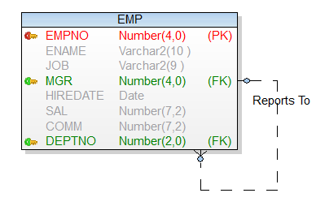
Joins – Self Join
Recursive Relationship
-- Self Join
SELECT e.*,
e2.ENAME AS MANAGER_NAME
FROM emp e
LEFT JOIN emp e2
ON e.MGR = e2.EMPNO
ORDER BY e2.ENAME

Slide 12
Joins – Cross Join
Cartesian Product
Think of a deck of cards: 4 suits x 13 ranks = 52 cards
-- Cross Join
SELECT *
FROM dept
cross join emp
SELECT *
FROM dept,
emp
Table A
Table B
Result
A
1
A1
A2
A3
B1
B2
B3
C1
C2
C3
B
2
C
3
Notes:
Cartesian joins are often done accidentally and can cause major performance issues. By using the ‘cross join’ syntax, this will tell others reading your code that you meant to do this and this join was intentional.

Slide 13
Union vs. Union All
Union will sort and remove dupes
Union all does neither and is faster
Union
Union All
A
A
-- Union
select *
from dept
union
select *
from dept_aux
-- Union all
select *
from dept
union all
select *
from dept_aux
B
B

Slide 14
Minus
Show rows from A that are not in B.
Minus
A
-- In A and not in B
select *
from dept
minus
select *
from dept_aux
-- In B and not in A
select *
from dept_aux
minus
select *
from dept
B

Slide 15
Built in Functions
Aggregate
Arithmetic
Character
Date / Time
System

Slide 16
Built in Functions
Deterministic:
Always gives same output as long as
all variables remain the same
Nondeterministic:
Always gives a different result
Notes:
This becomes important if you want to create a function base index. The function must be deterministic.
Examples of Nondeterministic: sysdate, guid

Slide 17
Built in Functions
Aggregate
  count
  sum
  avg
  max
  min

Slide 18
Built in Functions
Aggregate
-- Sum of SAL and count of employees
SELECT SUM(sal),
COUNT(*)
FROM emp
-- group by deptno
SELECT deptno,
SUM(sal),
COUNT(*)
FROM emp
GROUP BY deptno

Slide 19
Built in Functions
Arithmetic
  abs()
  ceil()
  floor()
  exp()
  ln()
  mod()
  power()
  sqrt()

Slide 20
Built in Functions
Arithmetic
SELECT avg(sal),
floor(avg(sal)),
ceil(avg(sal)),
sqrt(49),
COUNT(*)
FROM emp

Slide 21
Built in Functions
Character
  CONCAT()
  INSTR()
  HEX()
  LEFT()
  LENGTH()
  LOWER()
  REGEXP
  SUBSTRING()
  TRIM()
  UPPER()

Slide 22
Built in Functions
Character
SELECT ename,
CONCAT(ename, job),
INSTR(ename, 'O'),
LENGTH(ename),
LOWER(ename),
SUBSTR(ename,2,1),
TRIM(' SPACES '),
UPPER('lower case')
FROM emp

Slide 23

Built in Functions
Date / Time
SQL Server
CURRENT_TIMESTAMP
DATEADD
DATEDIFF
DATEFROMPARTS
DATENAME
DATEPART
DAY
GETDATE
GETUTCDATE
ISDATE
MONTH
SYSDATETIME
YEAR
ORACLE
ADD_MONTHS
CURRENT_TIMESTAMP
EXTRACT
LAST_DATE
MONTHS_BETWEEN
NEXT_DAY
SYSDATE
TO_DATE
TRUNC

Slide 24
Built in Functions
Date / Time
Oracle date data type: 7 bytes
Century
Year
Month
Date
Hour
Minute
Second
Date Mask:
mm/dd/yyyy hh24:mi:ss
11/15/2019 12:22:19

Slide 25
Built in Functions
Date / Time
SELECT sysdate,
to_char(sysdate, 'mm/dd/yyyy hh24:mi') time_string,
trunc(sysdate),
trunc(sysdate, 'MONTH'),
months_between(sysdate,hiredate),
round(months_between(sysdate,hiredate) / 12) as years,
ename,
extract(year from hiredate) as hire_year,
(sysdate - hiredate) / 365 as emp_years,
next_day(sysdate, 'friday'),
to_date('1/1/2020', 'mm/dd/yyyy')
FROM emp

Slide 26
Built in Functions
System
ORACLE
ROWID
ROWNUM
SYS_CONTEXT
SYS_GUID()
UID
USER
USERENV

Slide 27
Built in Functions
System
SELECT SYS_GUID(), UID, USER FROM DUAL
UNION ALL
SELECT SYS_GUID(), UID, USER FROM DUAL
UNION ALL
SELECT SYS_GUID(), UID, USER FROM DUAL;
SELECT ROWID AS X, ROWNUM FROM EMP;
SELECT SYS_CONTEXT ('USERENV', 'SESSION_USER') FROM DUAL;
SELECT SYS_CONTEXT ('USERENV', 'TERMINAL') FROM DUAL;
SELECT SYS_CONTEXT ('USERENV', 'HOST') FROM DUAL;
SELECT SYS_CONTEXT ('USERENV', 'OS_USER') FROM DUAL;
Notes:
SYS_GUID Generates a unique string. Example of a non-deterministic function.

Slide 28
Programable Objects
stored procedures
functions
triggers
views
packages (oracle only)

Slide 29
Stored Procedures
Oracle – PL/SQL
SQL Server – T-SQL (Transact-SQL)
Advantages:
Server Side processing – Keep data intensive processes near the data.
Ability to string multiple operations into a single ‘transaction’. All or nothing transaction.
Parameterize common business logic.
Performance: Ability to leverage set based (or bulk) operations. Much faster than ‘row by slow’ cursor loops.

Slide 30
Stored Procedures
Cannot be used in a select statement
CREATE OR REPLACE PROCEDURE ISSUE_RAISE(
P_PCT IN NUMBER,
P_SAL_TOTAL OUT NUMBER) AS
BEGIN
UPDATE EMP
SET SAL = SAL * (1 + (P_PCT / 100));
SELECT SUM(SAL)
INTO P_SAL_TOTAL
FROM EMP;
END;
/

Slide 31
Stored Procedures
Run using EXECUTE or in anonymous PL/SQL block
DECLARE
V_SAL NUMBER;
BEGIN
ISSUE_RAISE(3.5, V_SAL);
DBMS_OUTPUT.PUT_LINE('NEW SAL TOTAL: '||V_SAL);
END;
/

Slide 32
Functions
Can be used in a select statement
CREATE OR REPLACE FUNCTION ANNUAL_SAL(P_SAL NUMBER, P_COMM NUMBER)
RETURN NUMBER
AS
BEGIN
RETURN (P_SAL * 24) + (NVL(P_COMM,0) * 24);
END;
/
SELECT ename,
sal,
comm,
annual_sal(sal, comm)
FROM EMP;

Slide 33
Triggers
Code that ‘fires’ for a table on insert, update, or delete
Good for audit columns or complex data integrity rules
Avoid using for application logic
-- Add mod_date audit column
alter table emp add mod_date date;
-- Create trigger
CREATE OR REPLACE TRIGGER EMP_BIUR_TRG
BEFORE INSERT OR UPDATE
ON EMP
REFERENCING NEW AS New OLD AS Old
FOR EACH ROW
BEGIN
:NEW.MOD_DATE := SYSDATE;
END EMP_BIUR_TRG;
/

Slide 34
Views
Saved SQL that can be treated like a table
Views can be nested (views on views)
CREATE OR REPLACE VIEW emp_vw
as
SELECT e.*,
e2.ENAME AS MANAGER_NAME
FROM emp e
LEFT JOIN emp e2
ON e.MGR = e2.EMPNO
ORDER BY e2.ENAME;
-- TEST
select *
from emp_vw

Slide 35
Word of the Day…
Sargable
A query is said to be sargable if the DBMS engine can take advantage of an index to speed up the execution of the query. The term is derived from a contraction of Search ARGument ABLE. (ref: Wikipedia)

Slide 36
Reference
Oracle SQL Ref: https://docs.oracle.com/en/database/oracle/oracle-database/19/sqlrf/index.html
Microsoft SQL Server T-SQL ref: https://docs.microsoft.com/en-us/sql/t-sql/language-reference?view=sql-server-ver15
Additional SQL Training is available on Duke’s MyLearning page:
https://duke-energy.csod.com/LMS/catalog/Welcome.aspx
Demo scripts:
https://bitbucketp.duke-energy.com/scm/~bbuchan/sql_demo2.git

Slide 37

Appendix – hands on lab
Oracle Live SQL: https://livesql.oracle.com
Requires free Oracle login account
Setup:
-- copy emp table
create table emp
as
select * from scott.emp;
-- copy dept table
create table dept
as
select * from scott.dept;
-- insert 'orphan' emp row…
insert into emp
values(
7007, 'BUCHAN', 'CEO', null,
to_date('23-1-1998','dd-mm-yyyy'),
9999, null, null
);
commit;

Slide 38

Questions?

